Slide 1
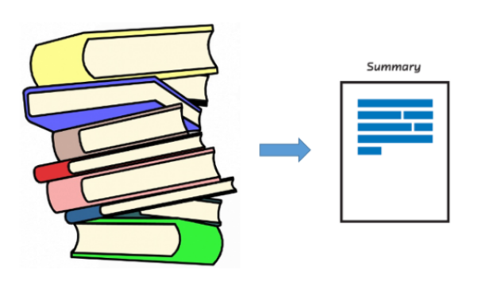
Text Summarization
BY
Zubair Mujawar (44)
Vedika Nalawade (45)
Shivam Parab(50)

Slide 2
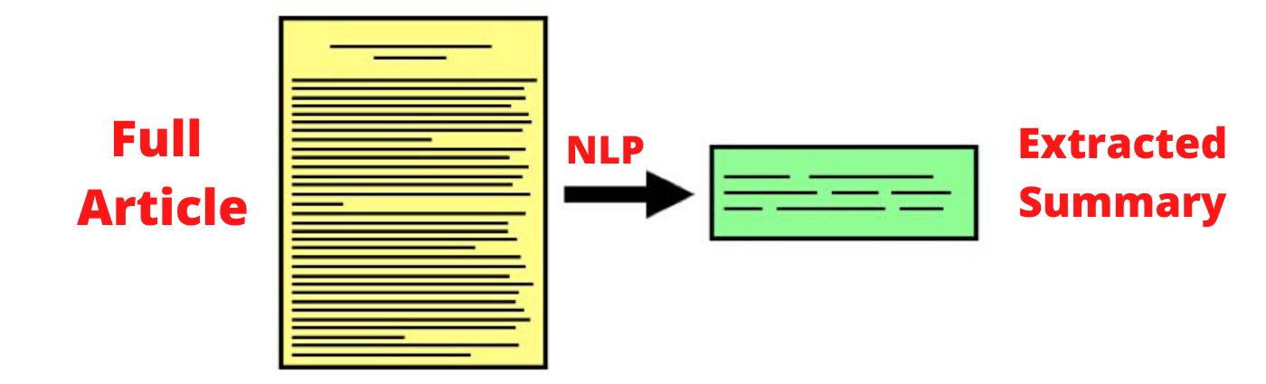
What Is Text Summarization Exactly?

Slide 3
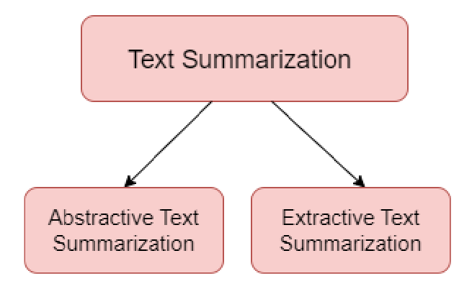
What Are Types of Text Summarization?

Slide 4
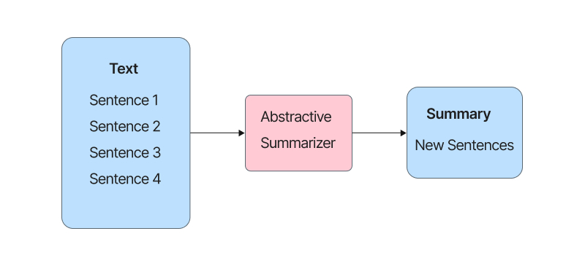
Abstractive Summarization

Slide 5
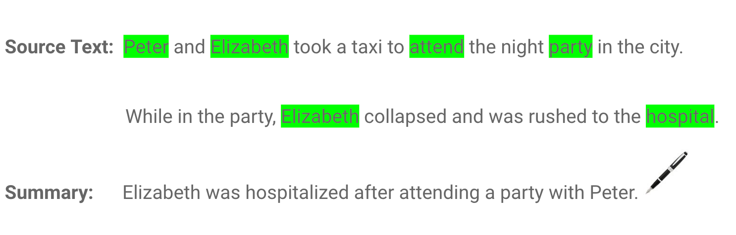

Slide 6
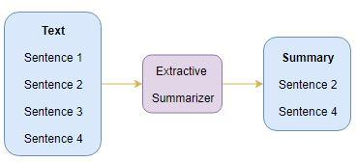
Extractive Summarization

Slide 7
Google Pegasus

Slide 8


Slide 9
Project Demonstration

